Slide 1

Life Insurance sales
Capstone Project
Presented by
Vivek Bhatia
January Batch-C-2022
Date: 15-January-2023

Slide 2
Table of Contents
Business Problem Understanding
Modelling Approach used and why
Insights and Analysis
Recommendations

Slide 3
Business Problem Understanding
Life Insurance Company
An Insurance Company that pays out a sum of money either on the death of the insured person or after a set period.
Agent Bonus
Insurance Agent
Customer
In lieu of his services an agent receives bonus computed either as a percentage of sum assured or a certain amount per Rs.1000/- sum assured.
An Insurance agent carries out intermediatory services between the client and the company and selling life policies that pay out when person dies or after maturity period.

Slide 4
Business Problem we are trying to solve
Predict the bonus for agents
Understanding business growth for long term strategies.
Predict the roadmap to upskill, reskill and reward based on the performance
Correctly analyze the performance metrics for agents
Constraints and Scope
20 different variables collected based on last month data
Data type –Object, Integer, Float
Data has missing value, outliers and certain unwanted columns
Agent bonus and sum assured per policy is not defined
Develop a model to accurately predict the bonus of agent

Slide 5
Modelling Approach Used & Why
Linearity of residuals –
Verified by Scatter Plot
Independence of residuals - Verified by Correlation or heat map
Normal distribution of residuals - verified by Histogram
Equal variance of residual- Verified by Scatter Plot
Perform EDA
Treat Data
Remove /Rename/Scale/ Merge and Drop Variables as required.
Encode the categorical variables.
Identify Target variable.
Split the data into train and test set.

Slide 6
Models Built
Bagging Regressor
ANN Regressor Model
ADA Boost Regressor
SK Learn Linear Regression Model
Random forest Regressor with Hyper Tuned Parameters
Random Forest Regressor
OLS Stats Model
OLS Stats Model Optimized with VIF
Decision Tree Regressor
Decision Tree Regressor with Hyper Tuned Parameters

Slide 7
Performance Metrices
MSE
(Mean Square Error)
MAPE
(Mean Absolute Percentage Error)
Performance Evaluation Metrics
RMSE
(Root Mean Square Error)
MAE
(Mean Absolute Error)
EVS
(Explained Variance Score)

Slide 8
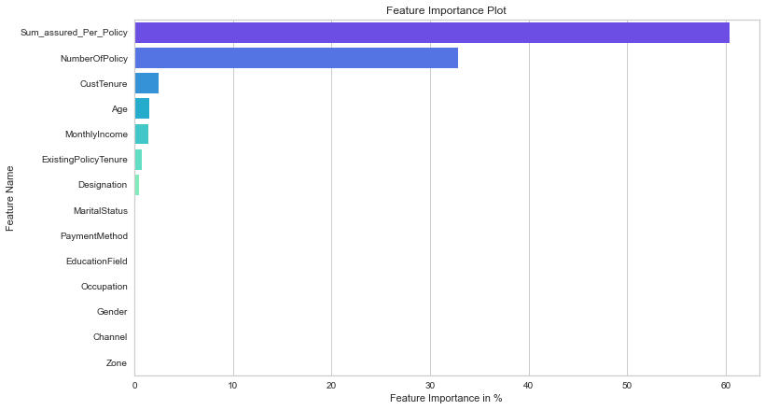
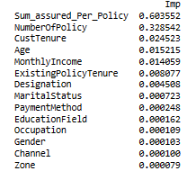
Random Forest Hyper Tuned Regressor Dashboard

Slide 9
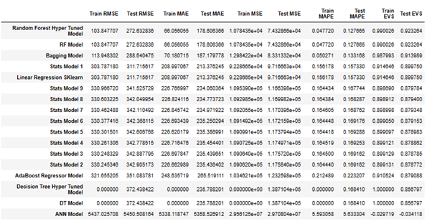
Insights from Analysis

Slide 10
Insights from Analysis
Random Forest Hyper Tuned Model has performed best among all the 17 models created using different regression techniques.
Basis RMSE we can say that we can expect an average difference of 272 in agent bonus per policy as per RF model or Random Forest Hyper Tuned Model.
Basis MAPE we can say that we can expect 12% deviation or variance in agent bonus per policy as per RF model or Random Forest Hyper Tuned Model.
ANN model has performed the worst with RMSE of 5450.50 and MAPE of 563.33%
Bagging regressor model comes second with RMSE of 288.64 and MAPE of 13.31%.

Slide 11
Recommendations
Channel
Maximum policies are sold via agents and the least number of policies are sold online
Agents are the most important vertical for sales
Loss of an agent can be attributed to loss of customer
Lack of clarity in understanding the information provided online
Employment
Salaried class are the highest buyer
Large business can be targeted for more sales
Gender & Marital Status
Proper marketing and awareness strategies needs to be implemented to make females more aware of the benefits of the policy.
Company needs to target unmarried class
Zone
East and South have very few customers and company needs to look into market opportunities in these zones to improve their market share. Best performing agents can be allotted those zones to improve sales.

Slide 12
Thank you

